Slide 1

Dynamic Content Monitoring and Exploration using Vector Spaces (ESR-2)
Benyou Wang
University of Padua
QUARTZ workshop, Copenhagen
03/04/2019

Slide 2
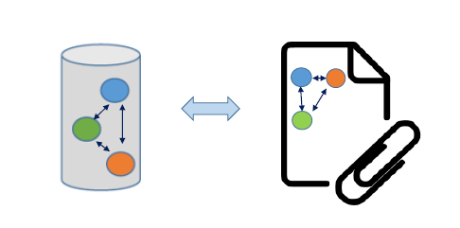
Vision
Representing and interpreting language inspired by Quantum Theory

Slide 3

State-of-the-art Paradigm for Language
How to compose a sequence of words
Abstraction
Feature
How to represent a single word?
Benyou Wang, Emanuele Di Buccio, Massimo Melucci. Representing Words in Vector Space and Beyond. Submitted to one Springer chapter organized by Andrei Khrennikov.

Slide 4
State-of-the-art Paradigm for Language
How to compose a sequence of words
Fasttext
CNN
Transformer
Abstraction
RNN
Neural Network
Feature
NNLM
W2V
BERT
How to represent a single word?
Glove
ELMO
Distributional hypothesis
Benyou Wang, Emanuele Di Buccio, Massimo Melucci. Representing Words in Vector Space and Beyond. Submitted to one Springer volume edited by Aerts, Khrennikov and Melucci.

Slide 5
Concerns (1) - Representation
Abstraction
How to compose a sequence of words
The weather is terrible in Copenhagen
The weather is nice in Copenhagen
terrible
nice
Feature
How to represent a single word?
Limitation of Distributional hypothesis

Slide 6
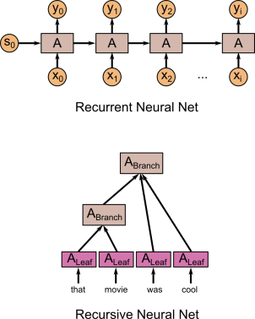
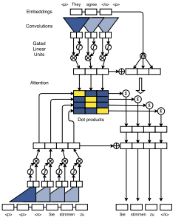
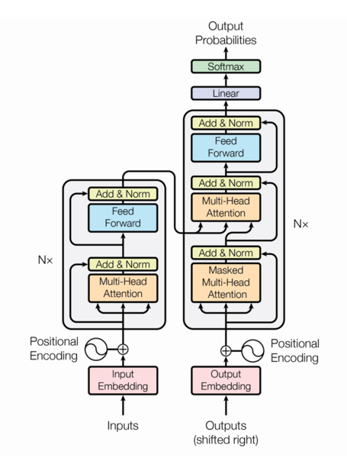
Concerns (1) - Representation
How to compose a sequence of words
Abstraction
Conv seq2seq
Transformer
How to model sequential tokens?
How to represent a single word?
Feature
https://pseudoprofound.wordpress.com/2016/06/20/recursive-not-recurrent-neural-nets-in-tensorflow/
Gehring, Jonas, et al. "Convolutional sequence to sequence learning." ICML 2017.
Vaswani, Ashish, et al. "Attention is all you need." NIPS 2017.

Slide 7

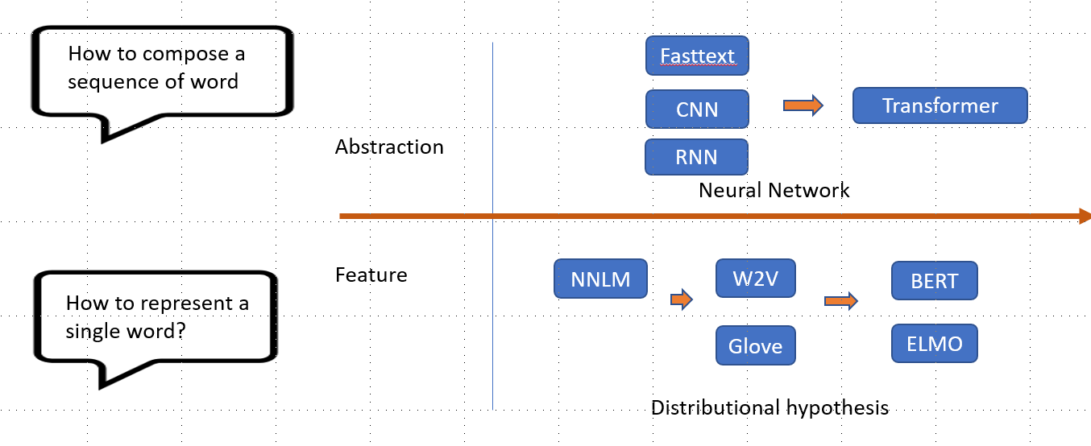
Concerns (2) - Interpretation
Kids store 1.5 megabytes of information to master their native language ？
So complicated !!!
How to interpret/understand this empirical framework with a more robust way,
like from a Mathematical/Physical perspective?
https://news.berkeley.edu/2019/03/27/younglanguagelearners/

Slide 8
Contents
Representations: Towards Complex-valued word embedding
Limitation of the Distributional Hypothesis
Sentiment-aware Complex word embedding
Extending sequential abstraction
Encoding position in Complex word embedding
Interpretation: From higher-dimensional Hilbert Space
Rethinking the neural network based NLP Paradigm in Tensor perspective

Slide 9




Semantic Hilbert Space
Bag of Words
Words in
Superposition States
Word Composition in Mixed State
Semantic Measurements
Probability $p_{1}$
…
Probability $p_{2}$
How to use phase empirically?
Probability $p_{k}$
Probability $p_{3}$
Benyou Wang*, Qiuchi Li*, Massimo Melucci, Dawei Song. Semantic Hilbert Space for Text Representation Learning. WWW 2019
Qiuchi Li*, Benyou Wang*, Massimo Melucci. CNM, a Complex-valued Matching Network for Matching. NAACL 2019

Slide 10
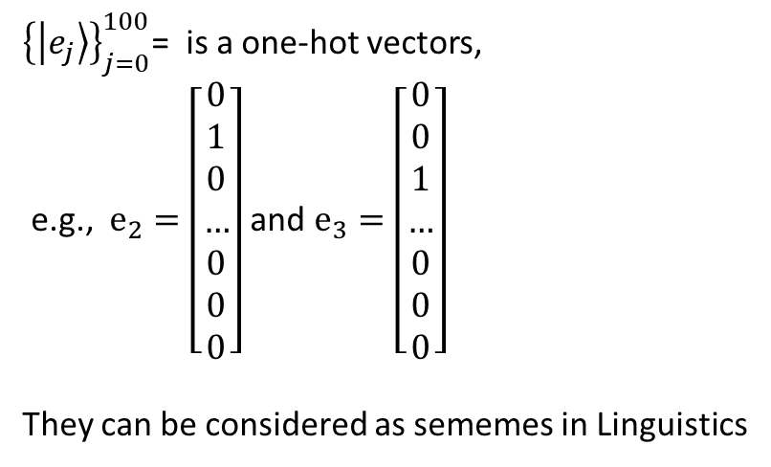
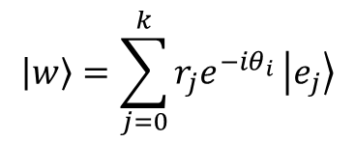


Sentiment-aware complex word embedding
General textual problems like sentiment classifications
$$\left|w\right\rangle =\sum_{j=0}^{k}{r_{j}e^{−iθ_{i}}}\left|e_{j}\right\rangle$$
Word polarity classification for a single word
${\left\{\left|e_{j}\right\rangle \right\}}_{j=0}^{100}$= is a one-hot vectors,
e.g., $e_{2}=\left[\begin{aligned}0 \\ 1 \\ 0 \\ … \\ 0 \\ 0 \\ 0\end{aligned}\right]$ and $e_{3}=\left[\begin{aligned}0 \\ 0 \\ 1 \\ … \\ 0 \\ 0 \\ 0\end{aligned}\right]$
They can be considered as sememes in Linguistics
$$\left[\begin{aligned}r_{1} \\ r_{2} \\ r_{2} \\ … \\ r_{k−2} \\ r_{k−1} \\ r_{k}\end{aligned}\right]$$
$$\left[\begin{aligned}θ_{1} \\ θ_{2} \\ θ_{2} \\ … \\ θ_{k−2} \\ θ_{k−1} \\ θ_{k}\end{aligned}\right]$$
Amplitude embedding
phase embedding
Complex-valued word embedding
The idea was discussed with Qiuchi Li, Sagar Uprety and Chen Zhang.

Slide 11
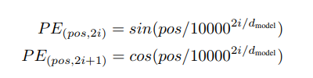
Position-aware complex word embedding
Position embedding in Conv Seq2seq [1]
Position embedding in Transformer[2]
I
Love
…
Copenhagen
1st position
2nd position
3rd position
…
Word
Embedding
Position
Embedding
Do not need training !!!
We proved that the position embedding in Transformer can be derived from Complex-valued word embedding
“I love Copenhagen”
[1] Gehring, Jonas, et al. "Convolutional sequence to sequence learning." ICML 2017.
[2] Vaswani, Ashish, et al. "Attention is all you need." NIPS 2017.
The idea was discussed with Donghao Zhao and Qiuchi Li.

Slide 12
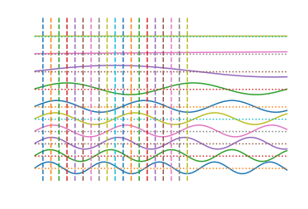

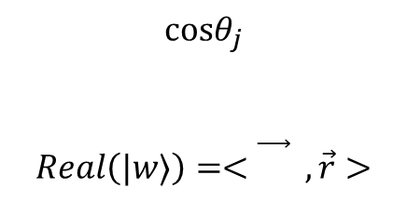






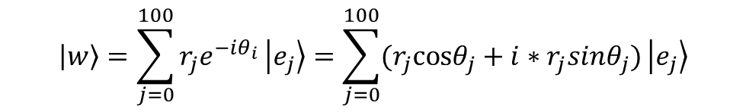



Position-aware complex word embedding
$$\left|w\right\rangle =\sum_{j=0}^{100}{r_{j}e^{−iθ_{i}}}\left|e_{j}\right\rangle =\sum_{j=0}^{100}{(r_{j}cosθ_{j}+{i∗r}_{j}sinθ_{j})}\left|e_{j}\right\rangle$$
$$d_{100}$$
$$d_{50}$$
$$cosθ_{j}$$
$$Real\left(|w⟩\right)=<\vec{} , \vec{r}>$$
$$d_{20}$$
$$d_{10}$$
$$d_{6}$$
$$d_{5}$$
$$d_{4}$$
$$d_{3}$$
$$d_{2}$$
$$d_{1}$$
Word in different position has different phase, resulting in different word embedding
https://gist.github.com/wabyking/83ab87327e707b3e2834e2f37cac6bcf is used to draw the figure
The idea was discussed with Donghao Zhao and Qiuchi Li.

Slide 13
Contents
Representations: Towards Complex-valued word embedding
Limitation of the Distributional Hypothesis
Sensitive-aware Complex word embedding
Extending sequential abstraction
Encoding position in Complex word embedding
Interpretation: From higher-dimensional Hilbert Space
Rethinking the neural network based NLP Paradigm in tensor perspective

Slide 14
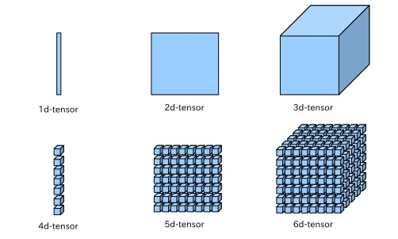
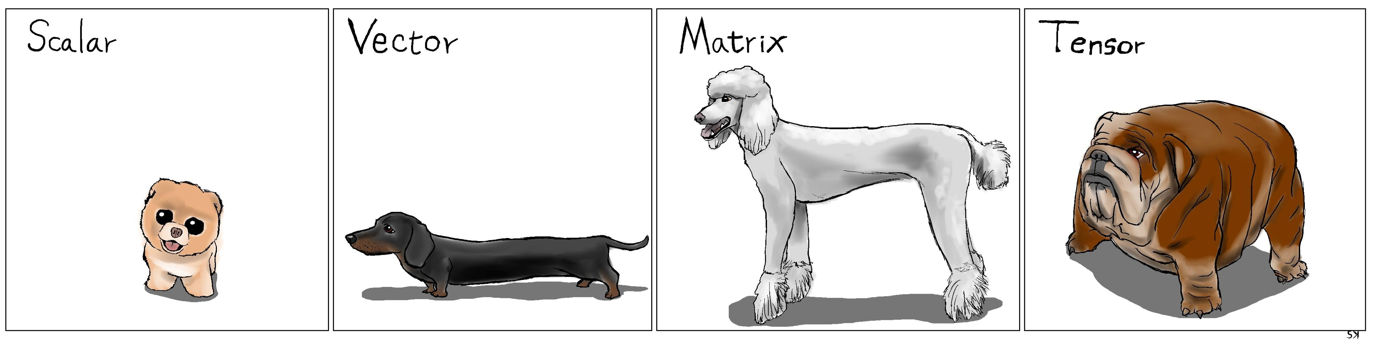
What is tensor?
The number of publications on tensor increases exponentially over recent years;

Slide 15
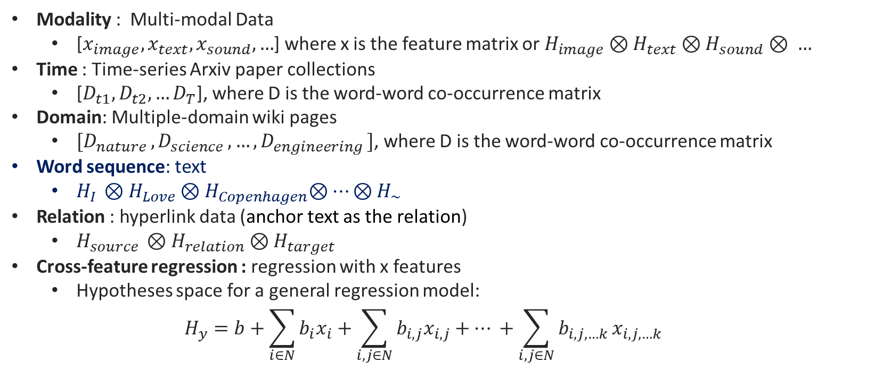
Tensor is everywhere– find the third and higher dimensions
Modality : Multi-modal Data
[$x_{image},x_{text},x_{sound},…$] where x is the feature matrix or $H_{image}⊗H_{text}⊗H_{sound}⊗ …$
Time : Time-series Arxiv paper collections
[$D_{t1},D_{t2},…D_{T}$], where D is the word-word co-occurrence matrix
Domain: Multiple-domain wiki pages
${[D}_{nature }{,D}_{science},…,D_{engineering }]$, where D is the word-word co-occurrence matrix
Word sequence: text
$H_{I }⊗H_{Love}{⊗H}_{Copenhagen}⊗…⊗H_{\sim }$
Relation : hyperlink data (anchor text as the relation)
$H_{source }⊗H_{relation}{⊗H}_{target}$
Cross-feature regression : regression with x features
Hypotheses space for a general regression model:
$$H_{y}=b+\sum_{i∈N}{b_{i}x_{i}}+\sum_{i,j∈N}{b_{i,j}x_{i,j}}+… +\sum_{i,j∈N}{b_{i,j,…k }x_{i,j,…k}}$$

Slide 16






Tensor representation in Text
One-hot Tensor representation
Distributed Tensor representation
Generally speaking, $\left|V\right|≫k$
$$\left|w\right\rangle =\left[\begin{aligned}0 \\ 1 \\ 0 \\ … \\ 0 \\ 0 \\ 0\end{aligned}\right]$$
For a sentence “I Love Copenhagen”
$\left|Φ_{s}\right\rangle = |w_{1}⟩⊗|w_{2}⟩⊗|w_{3}⟩$ $⊗…|W_{n}⟩$
e.g., $|I⟩⊗|love⟩⊗|Copenhagen⟩$
$$\left|Φ_{s}\right\rangle ∈R^{{\left|V\right|}^{N}}$$
$$\left|w\right\rangle =\sum_{j=0}^{k}{r_{j}e^{−iθ_{i}}}\left|e_{j}\right\rangle$$
$$\left|Φ_{s}\right\rangle ∈R^{k^{N}}$$

Slide 17
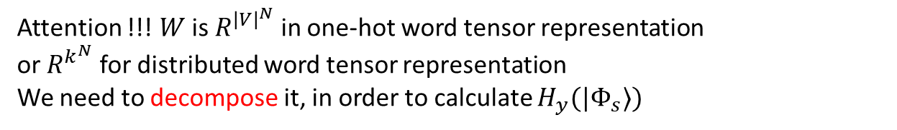
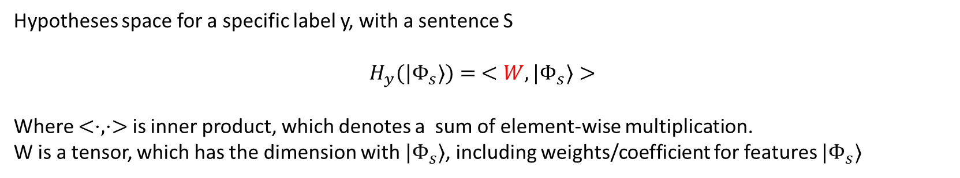
Hypotheses space with tensor representation
Hypotheses space for a specific label y, with a sentence S
$$H_{y}(|Φ_{s}⟩)= <W,|Φ_{s}⟩>$$
Where $<⋅,⋅>$ is inner product, which denotes a sum of element-wise multiplication.
W is a tensor, which has the dimension with $|Φ_{s}⟩$, including weights/coefficient for features $|Φ_{s}⟩$
Attention !!! $W$ is $R^{{\left|V\right|}^{N}}$ in one-hot word tensor representation
or $R^{k^{N}}$ for distributed word tensor representation
We need to decompose it, in order to calculate $H_{y}(|Φ_{s}⟩)$

Slide 18
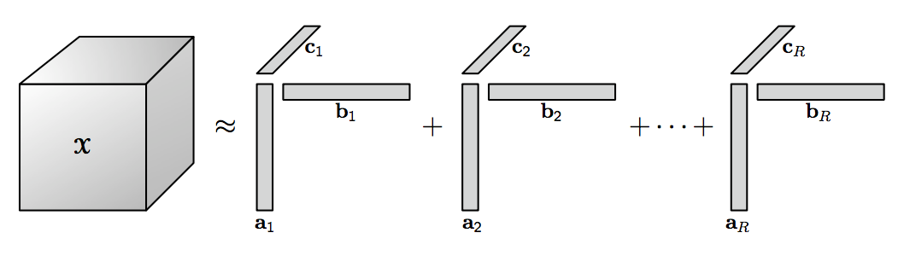
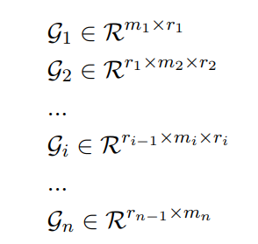










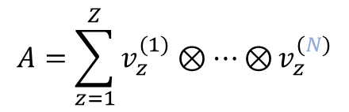


Tensor Decomposition
$$A=\sum_{z=1}^{Z}{v_{z}^{(1)}⊗…⊗}v_{z}^{(N)}$$
Tensor train (TT) Decomposition
CP Decomposition
$$r_{1}$$
$$r_{2}$$
$$r_{3}$$
$$r_{i−1}$$
$$r_{i}$$
$$r_{n−1 }$$
$$m_{1}r_{1}$$
$${r_{1}m}_{2}r_{2}$$
$${r_{2}m}_{3}r_{3}$$
$${r_{i−1}m}_{i}r_{i}$$
$$r_{n−1 }m_{n}$$
Tucker Decomposition
Tensors are decomposed to a sequential multiplication of some 3-order tensors

Slide 19
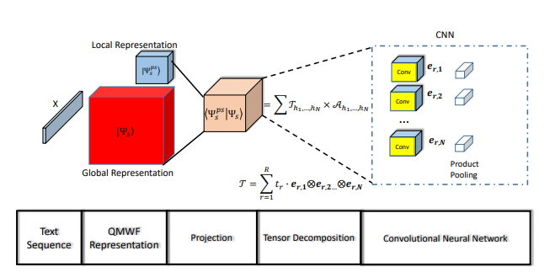
CP Decomposition for distributed text tensor
Zhang P, Su Z, Zhang L, Wang B, Song D. A quantum many-body wave function inspired language modeling approach. In Proceedings of the 27th ACM CIKM 2018 Oct 17 (pp. 1303-1312). ACM.

Slide 20
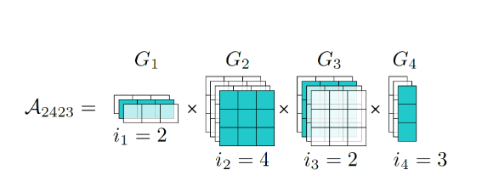

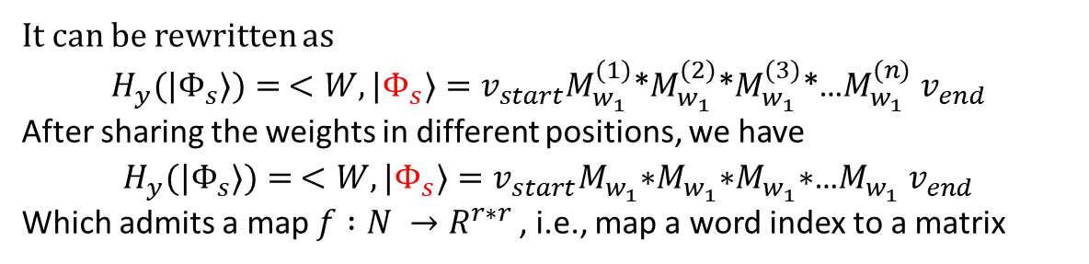
TT-Decomposition for one-hot text tensor
One-hot tensor
$$H_{y}(|Φ_{s}⟩)= <W,|Φ_{s}⟩>$$
A computing demo of $H_{y}(|Φ_{s}⟩),$ if $|Φ_{s}⟩$ is one-hot
It can be rewritten as
$$H_{y}(|Φ_{s}⟩)= <W,|Φ_{s}⟩={v_{start}M}_{w_{1}}^{(1)}\text{∗}M_{w_{1}}^{(2)}\text{∗}M_{w_{1}}^{(3)}\text{∗…}M_{w_{1}}^{(n)} v_{end}$$
After sharing the weights in different positions, we have
$$H_{y}(|Φ_{s}⟩)= <W,|Φ_{s}⟩={v_{start}M}_{w_{1}}^{}\text{∗}M_{w_{1}}^{}\text{∗}M_{w_{1}}^{}\text{∗…}M_{w_{1}}^{} v_{end}$$
Which admits a map $f :N →R^{r∗r }$, i.e., map a word index to a matrix

Slide 21
Research Activities
Recent activities
Courses in University of Padova, like Applied Functional Analysis.
English course including speaking, grammar and listening.
Publications:
Qiuchi Li*, Benyou Wang*, Massimo Melucci. A Complex-valued Network for Matching. NAACL 2019 (oral presentation)
Benyou Wang*, Qiuchi Li*, Massimo Melucci, Dawei Song. Semantic Hilbert Space for Text Representation Learning. WWW 2019 (short paper)
Wei Zhao*, Benyou Wang*, Min Yang, Jianbo Ye, Zhou Zhao, Xiaojun Chen, Ying Shen. Leveraging Long and Short-term Information in Content-aware Movie Recommendation via Adversarial Training. IEEE Transactions on Cybernetics (TOC), 2019
The following research activities:
Conferences : I will attend the WWW 2019 and NAACL 2019 if visa can be ready
August – October 2019 : Secondment in University of Copenhagen
October – December 2019 : Secondment in University of Montreal
* means equal contribution

